Slide 1
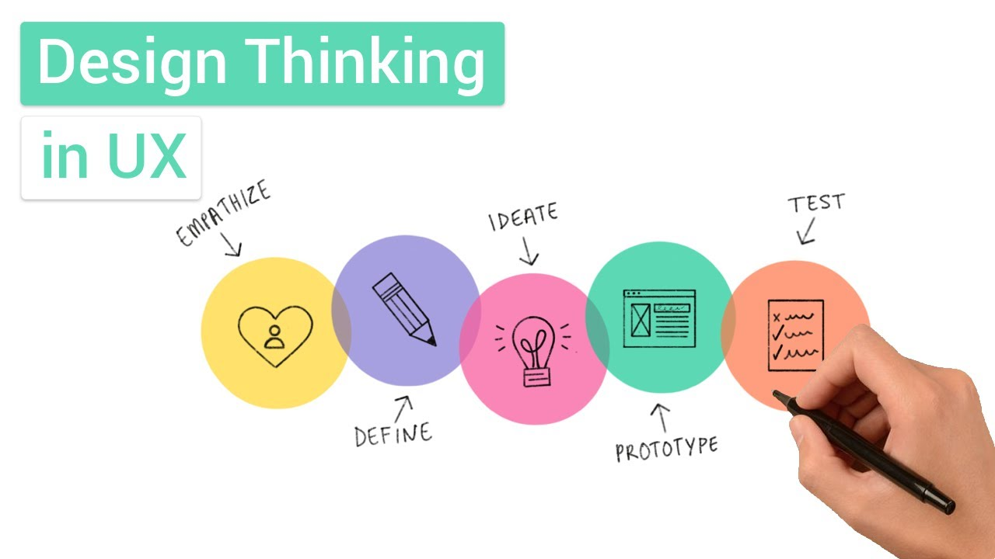
DESIGN THINKING PROCESS
Design thinking is an approach to problem-solving that focuses on innovation and creation. UX/UI Designers use the design thinking process to discover problems and come up with creative solutions by thoroughly understanding their users' goals, frustrations, and end-task.

Slide 2
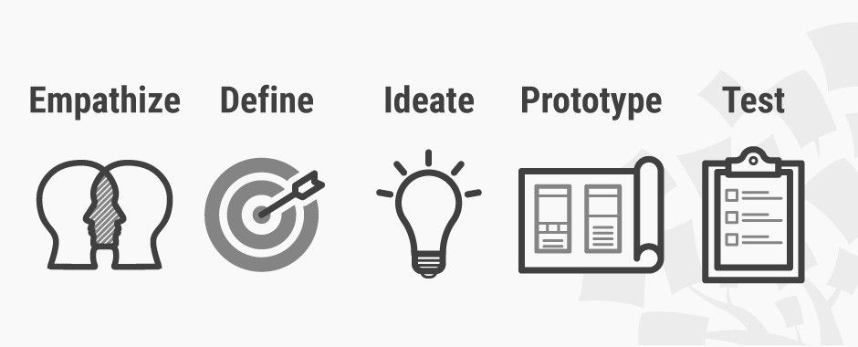
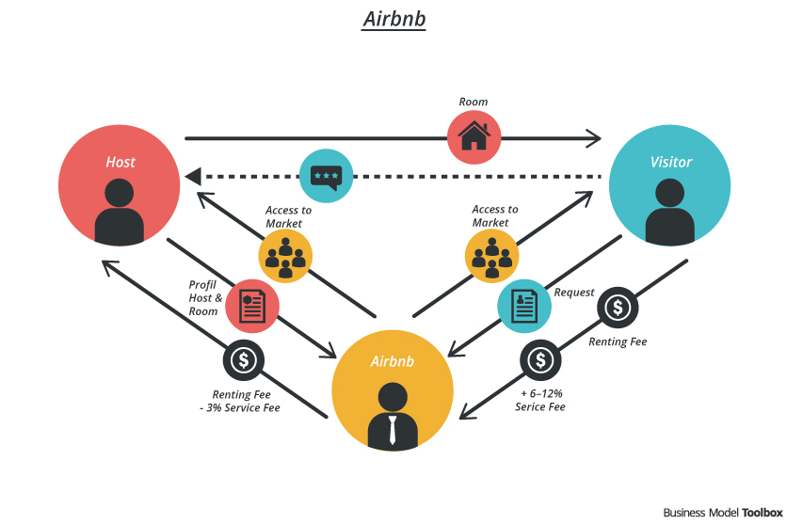
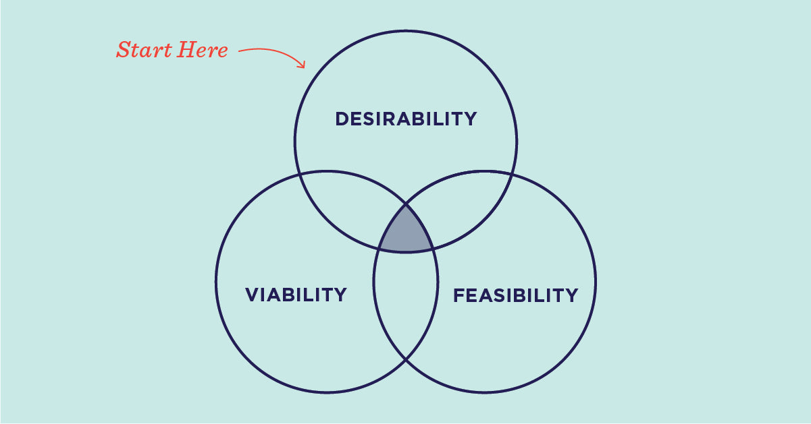
EXAMPLES OF DESIGN THINKING PROCESS

